Slide 1

SPAM MESSAGE CLASSIFICATIOM

Slide 2
CONTENTS
PROBLEM STATEMENT
DATASET
GOAL OF ANALYSIS
MODEL CHOICES
MODEL RESULTS
CONCLUSION
Notes:
a). Introduce your data
b). Describe what you are doing with your data; that is, the goal of your analysis
c). Introduce your models/methods, give some details about how you run the models & show some of your code that you think is interesting
d). Show the output/results of your analysis, and then conclude the presentation with discussions on findings or model choices based on your analysis

Slide 3
PROBLEM STATEMENT
Spam has become the bane of existence for many users and entities providing email services. Time is lost when sifting through unwanted messages and important emails may be lost through omission or accidental deletion.
The upsurge in the volume of unwanted emails and text messages called spam has created an intense need for the development of more dependable and robust antispam filters
Notes:
https://link.springer.com/referenceworkentry/10.1007%2F978-0-387-30164-8_828
A great deal of sitrubence for a lot of individausls

Slide 4
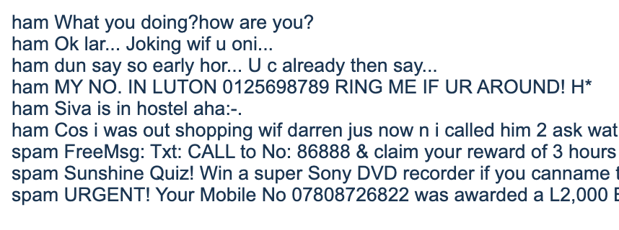
DATASET
Dataset consists of 5574 instances
Label
ham - legimate sms
spam - illegitimate sms
SMS messages
A collection of sms spam messages extracted
Grumbletext Website - 425 messages
NUS SMS Corpus – 3375 messages
Caroline Tag’s PhD – 450 messages
Notes:
This corpus has been collected from free or free for research sources at the Internet: -> A collection of 425 SMS spam messages was manually extracted from the Grumbletext Web site. This is a UK forum in which cell phone users make public claims about SMS spam messages, most of them without reporting the very spam message received. The identification of the text of spam messages in the claims is a very hard and time-consuming task, and it involved carefully scanning hundreds of web pages. The Grumbletext Web site is: [Web Link]. -> A subset of 3,375 SMS randomly chosen ham messages of the NUS SMS Corpus (NSC), which is a dataset of about 10,000 legitimate messages collected for research at the Department of Computer Science at the National University of Singapore. The messages largely originate from Singaporeans and mostly from students attending the University. These messages were collected from volunteers who were made aware that their contributions were going to be made publicly available. The NUS SMS Corpus is avalaible at: [Web Link]. -> A list of 450 SMS ham messages collected from Caroline Tag's PhD Thesis available at [Web Link]. -> Finally, we have incorporated the SMS Spam Corpus v.0.1 Big. It has 1,002 SMS ham messages and 322 spam messages and it is public available at: [Web Link]. This corpus has been used in the following academic researches:
ry
Number of Instances:
5574

Slide 5
GOAL OF ANALYSIS
The goal of this analysis is to classify the text data into spam and ham to determine legitimate message and spam messages
The data will be used to create a model to predict the class of unseen records

Slide 6
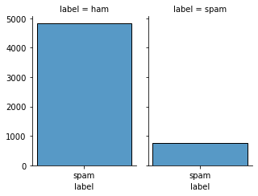
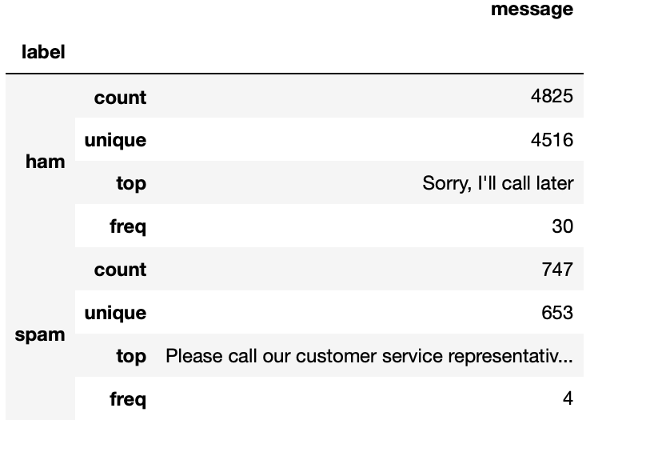
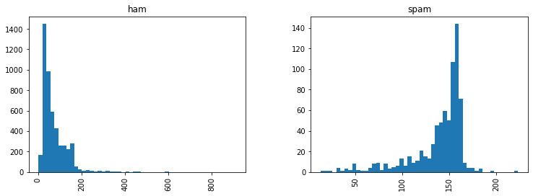
EXPLORATORY DATA ANALYSIS
Overall, the trend reveals spam messages tend to have more characters than regular messages, but overall, the dataset has more occurrences of regular messages(ham) than spam messages (imbalance dataset)
Notes:
a trend that spam messages tend to have more characters.

Slide 7
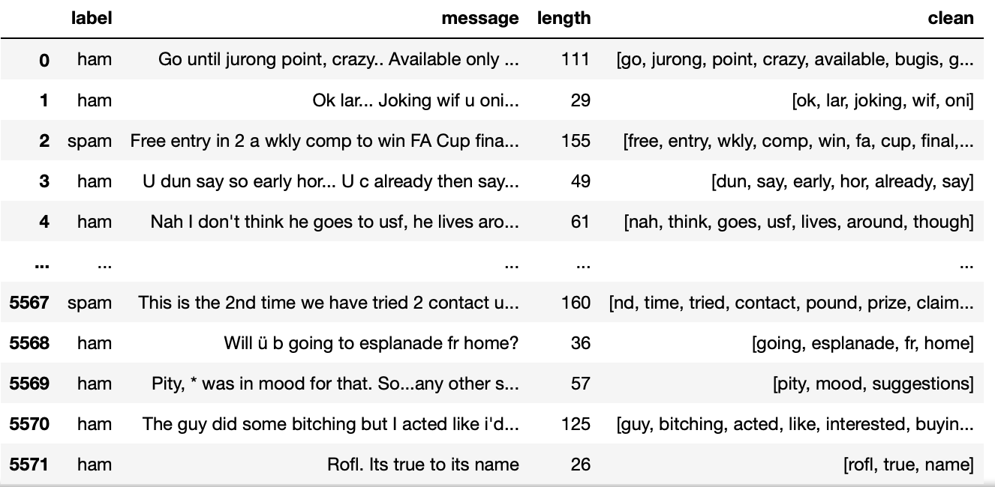
PRE PROCESSING
Natural Language Processing
Takes in a string of text, then performs the following:
Stemming
Lemmatization
Tokenization
Remove all punctuation
Remove all stopwords
Remove numbers
Remove special characters
Lower case text
Returns a list of the cleaned text

Slide 8
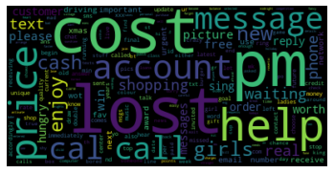
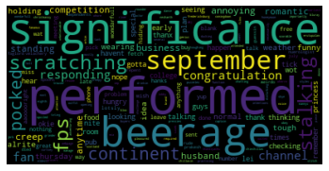
WORD CLOUD
SPAM(ILLEGITIMATE SMS) WORD FREQUENCY
HAM(LEGITIMATE SMS) WORD FREQUENCY

Slide 9
MODEL CHOICES
LogisticRegression
KNeighborsClassifier
DecisionTreeClassifier
RandomForestClassifier
MLPClassifier
EnsembleClassifier

Slide 10
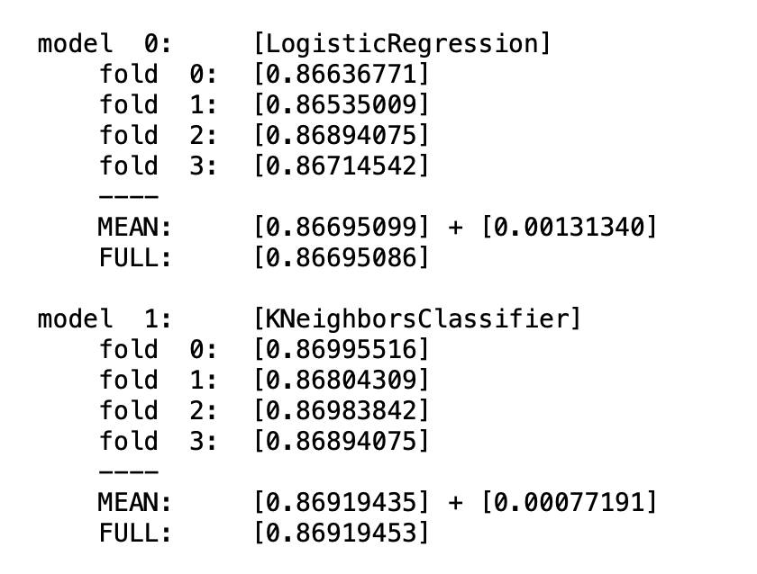
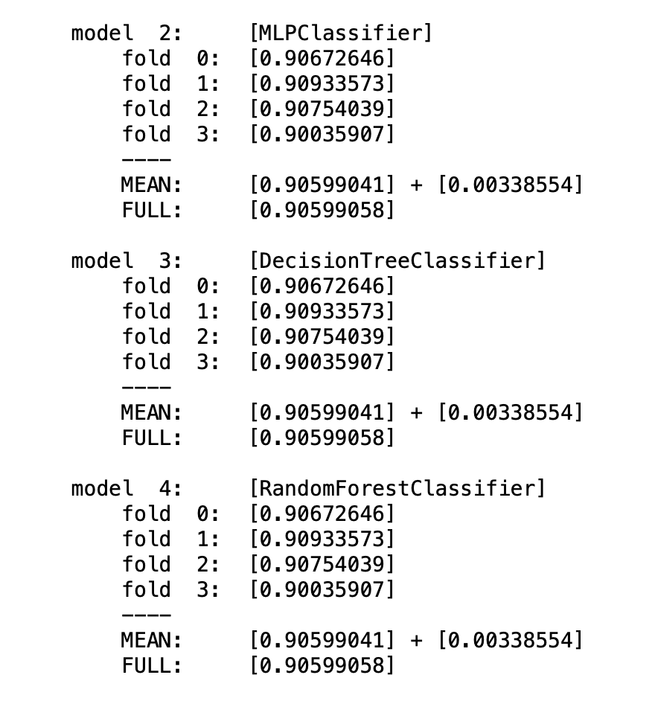
ENSEMBLE MODEL
Imbalanced data Result Majority class – Legitimate SMS (ham)
5 Base models
Logistic Regression
KNN
Neural Net
Decision Tree
Random Forest
K- fold cross validation
4
Stacking model
XGBClassifier

Slide 11
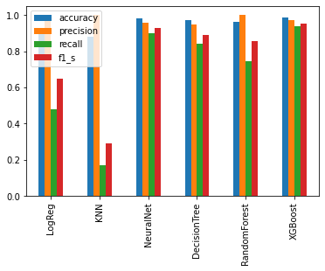
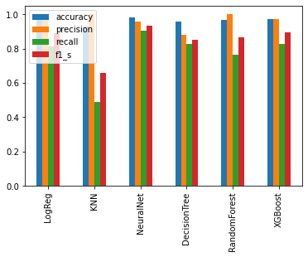
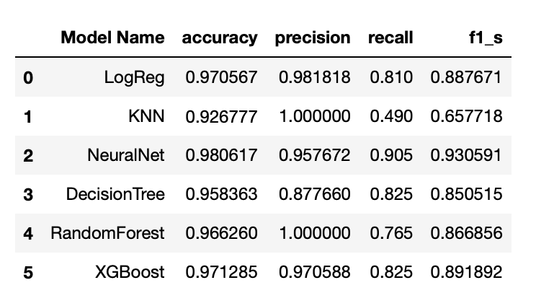
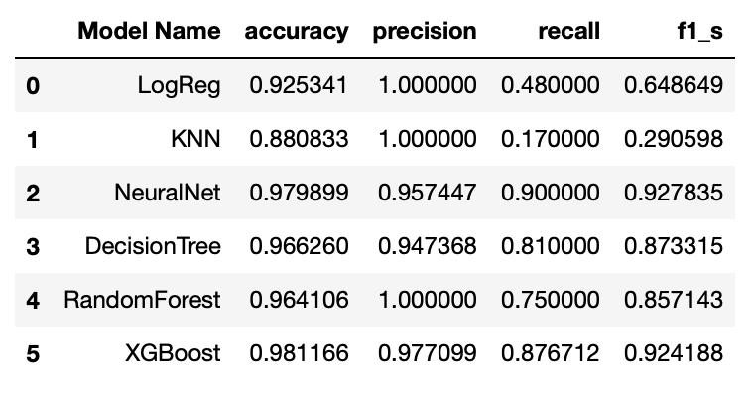
MODEL RESULTS
Imbalanced data
SMOTE data
The Stacking algorithm(XGBoost) outperformed the other models with an accuracy of 98% (Imbalanced data) and 97%(SMOTE data)
SMOTE: Synthetic Minority Over-sampling Technique has been designed to generate new samples that are coherent with the minor class distribution.
Similar output with imbalanced dataset but higher accuracy, recall and f1 score specifically for Logistic Regression and KNN models
Notes:
-SMOTE: Synthetic Minority Over sampling Technique (SMOTE) algorithm applies KNN approach where it selects K nearest neighbors, joins them and creates the synthetic samples in the space. The algorithm takes the feature vectors and its nearest neighbors, computes the distance between these vectors. The difference is multiplied by random number between (0, 1) and it is added back to feature. SMOTE algorithm is a pioneer algorithm and many other algorithms are derived from SMOTE.

Slide 12
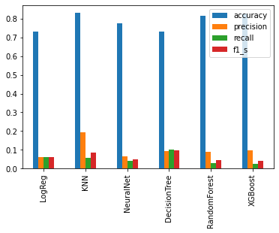
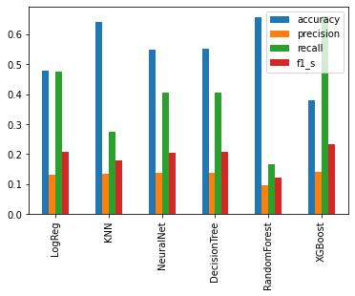
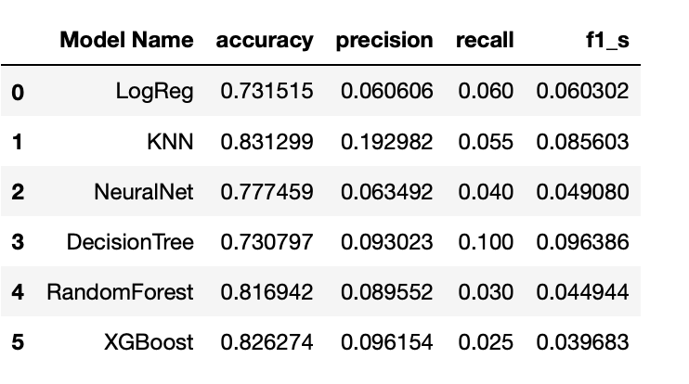
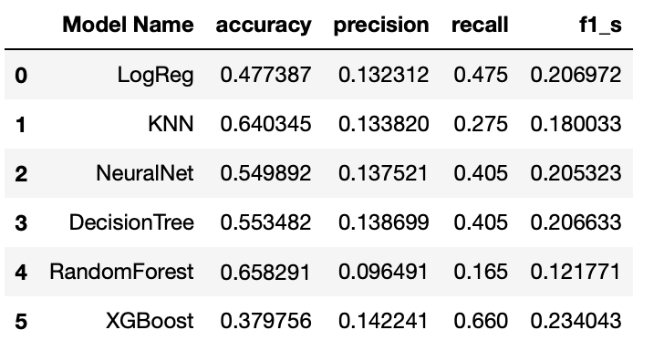
MODEL RESULTS
Over Sampling minority class
Under sampling majority class
Stacking algorithm(XGBoost) outperformed the other models with an accuracy of
Both oversampling and under sampling revealed below par results, undersmapling had low metrics for all metric categories and oversampling
Notes:
-SMOTE: Synthetic Minority Over sampling Technique (SMOTE) algorithm applies KNN approach where it selects K nearest neighbors, joins them and creates the synthetic samples in the space. The algorithm takes the feature vectors and its nearest neighbors, computes the distance between these vectors. The difference is multiplied by random number between (0, 1) and it is added back to feature. SMOTE algorithm is a pioneer algorithm and many other algorithms are derived from SMOTE.

Slide 13

FUTURE WORK
Deal with imbalanced data to improve metrics
Source for more spam/ham text data
Hyper parameter tuning of current models
Try using variants of SMOTE.

Slide 14

THANK YOU!

